Slide 1
VIDYA JYOTHI INSTITUTE OF TECHNOLOGY (Autonomous)
VOICE CONTROLLER DESKTOP ASSISTANCE
Guided By:
Dr. Md Zaheer Ahmed
Assistant Professor
TEAM MEMBERS :
1.DEEPA SRI VADLA [ 23911A0514 ]
Project Coordinator
Dr.Ch.Deepika /
Mrs.G.Kalpana /
Mr.V.Narsing Rao

Slide 2
CONTENTS
Review1:
Introduction
Abstract
Literature Survey
Drawbacks of Existing System
Proposed System
Software and Hardware Requirements
Review2:
Modules
Architecture
UML Diagrams/Flow chats/DFD
Implementation
Review3:
Testing
Results/Output screens
Conclusion
Future Scope
Draft Documentation

Slide 3
INTRODUCTION
In recent years, voice-based technologies have become important in improving human–computer interaction.
Voice assistants allow users to perform tasks using speech instead of traditional input devices like keyboard and mouse. This makes interaction faster, easier, and more convenient, especially for hands-free operation.
This project focuses on developing a Python-based voice assistant named Jarvis. The system can understand voice commands, process them, and perform tasks such as opening applications, searching information, and responding through voice output.
It also helps in understanding real-time processing and automation concepts.

Slide 4
ABSTRACT
Jarvis is a Python-based voice assistant developed to make human–computer interaction easier and more natural. It allows users to perform basic tasks using voice commands instead of manual input. The assistant listens to the user’s voice, converts speech into text, processes the command, and responds through voice output, providing a user-friendly experience.
The system is built using Python libraries such as Speech Recognition for voice input processing and pyttsx3 for text-to-speech conversion. Jarvis can perform tasks like searching information on Wikipedia, opening websites such as Google and YouTube, playing music, and telling the current time. This project helps in understanding speech processing and automation concepts and demonstrates how Python can be used to build simple and effective voice-based applications.

Slide 5
LITERATURE SURVEY
Voice assistants like Google Assistant, Amazon Alexa, and Apple Siri have improved human–computer interaction using voice commands.
These systems use speech recognition and natural language processing to understand user input and provide responses.
Research shows that voice-based systems increase efficiency and reduce manual effort in daily tasks.
Python-based voice assistants are widely developed using libraries such as SpeechRecognition and pyttsx3 for speech processing.
Existing systems are powerful but can be complex and require internet connectivity.
This project focuses on building a simple, offline-capable voice assistant using Python for basic automation tasks.

Slide 6
DRAWBACKS OF EXISTING SYSTEM
Relies on keyboard and mouse input
Requires continuous manual effort
Time-consuming for repetitive tasks
No voice command support
Limited automation capabilities
Less user-friendly interaction
Not suitable for hands-free usage
Less accessible for physically challenged users

Slide 7
PROPOSED SYSTEM
Uses voice commands for interaction
Converts speech into text using speech recognition
Processes commands using Python logic
Executes tasks automatically (open apps, search info, etc.)
Converts output into speech using text-to-speech
Provides faster, easier, and user-friendly experience
Lightweight and cost-effective system

Slide 8
SOFTWARE AND HARDWARE REQUIREMENTS
Software Requirements Operating System: Windows Programming Language: Python Libraries: pyttsx3 , Speech Recognition, Wikipedia IDE: VS Code | Hardware Requirements Computer or Laptop Microphone or Headset Internet connection (for speech recognition)

Slide 9
MODULES
The system is divided into different modules for better functionality:
Voice Input Module: Captures user voice using microphone
Speech Recognition Module: Converts voice into text
Command Processing Module: Analyzes command using Python logic
Task Execution Module: Performs required actions
Voice Output Module: Converts response into speech
This modular design improves flexibility and scalability.

Slide 10
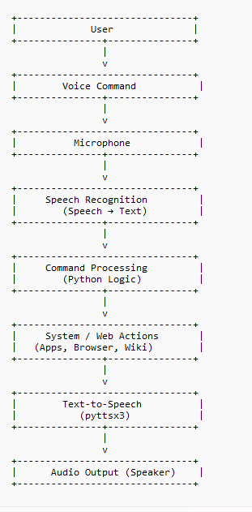
ARCHITECTURE
User gives voice input
Microphone captures audio
Speech Recognition converts audio
to text
Python logic processes the command
Required action is performed
pyttsx3 converts response text into
speech

Slide 11
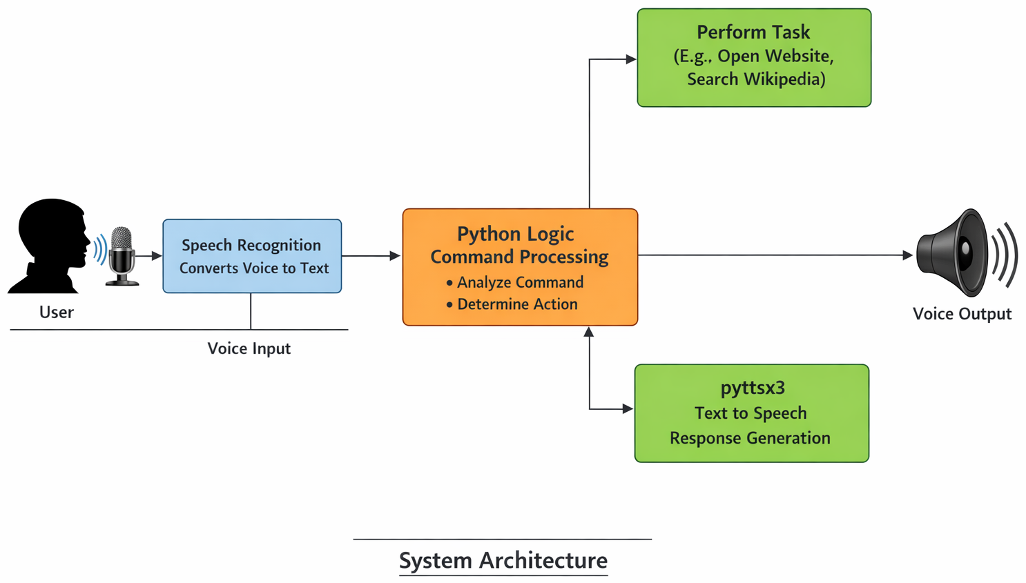
ARCHITECTURE

Slide 12
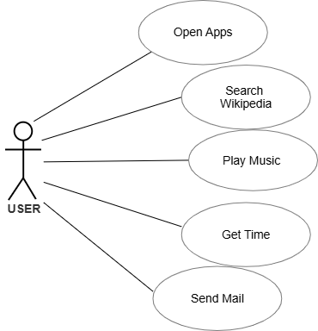
UML DIAGRAMS (USE CASE)

Slide 13
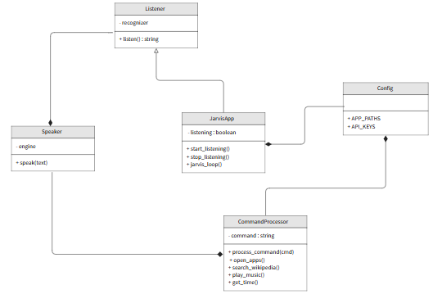
UML DIAGRAM (CLASS DIAGRAM)

Slide 14
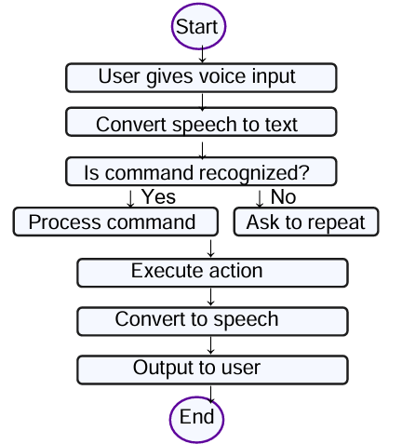
ACTIVITY DIAGRAM

Slide 15
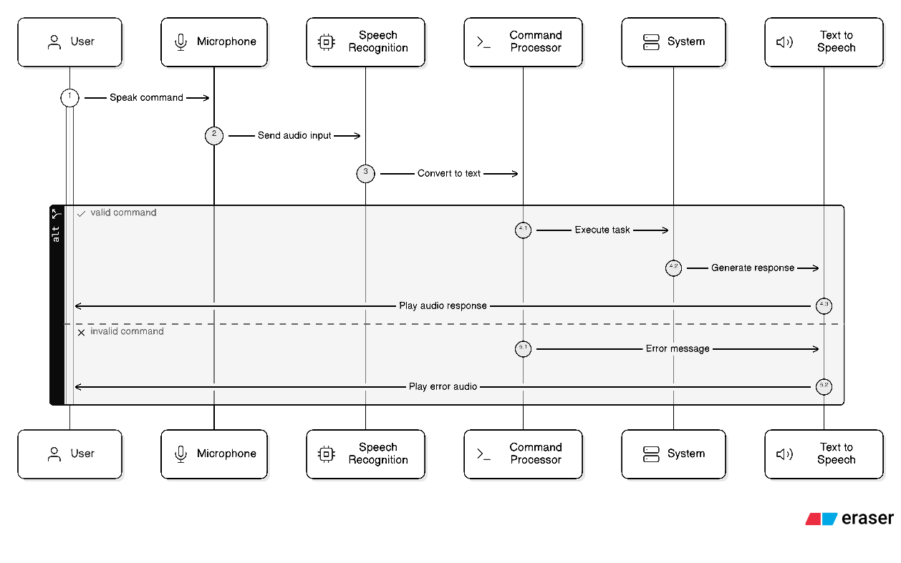
SEQUENCE DIAGRAM

Slide 16
IMPLEMENTATION
The system is implemented using Python with different libraries:
SpeechRecognition → Converts speech to text
pyttsx3 → Converts text to speech
webbrowser → Opens websites
os module → Opens applications
datetime → Provides time
The system uses conditional statements (if-elif) to process commands and execute tasks. It follows a modular approach for easy development and maintenance.

Slide 17
SYSTEM TESTING
Different types of testing are performed:
Unit Testing: Each module tested individually
Integration Testing: Ensures modules work together
User Acceptance Testing: Tested by users for usability
Output Testing: Checks correctness of results
Performance Testing: Measures speed and response time
Error Handling Testing: Handles invalid or unclear inputs

Slide 18
RESULTS/OUTPUT SCREENS
The system produced successful results:
Recognizes voice input accurately
Opens applications and websites
Retrieves information from Wikipedia
Plays music from system
Tells current time
Provides clear voice output

Slide 19
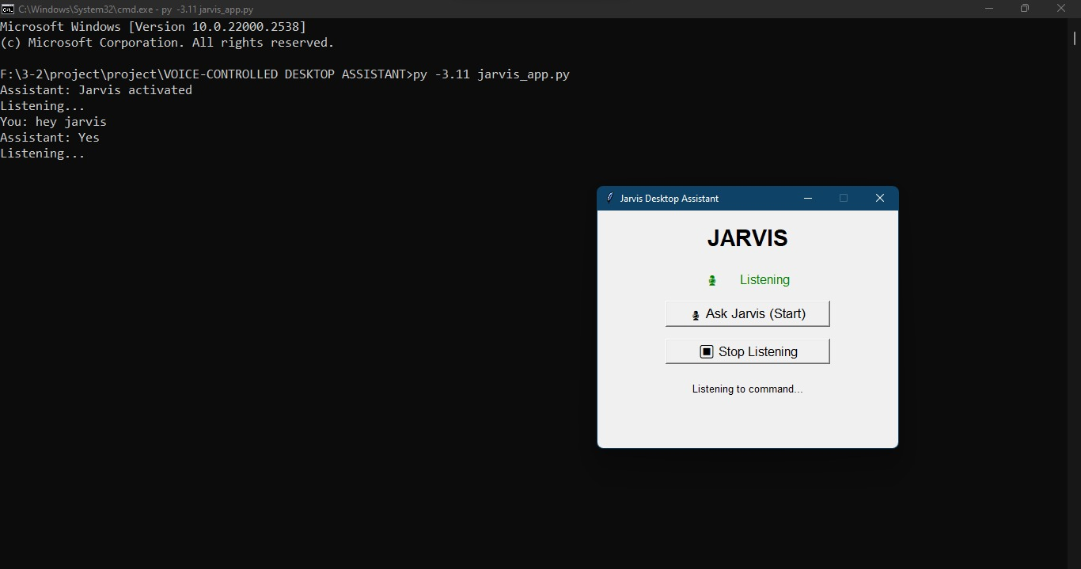
RESULTS/OUTPUT SCREENS

Slide 20

RESULTS/OUTPUT SCREENS

Slide 21
RESULTS/OUTPUT SCREENS

Slide 22
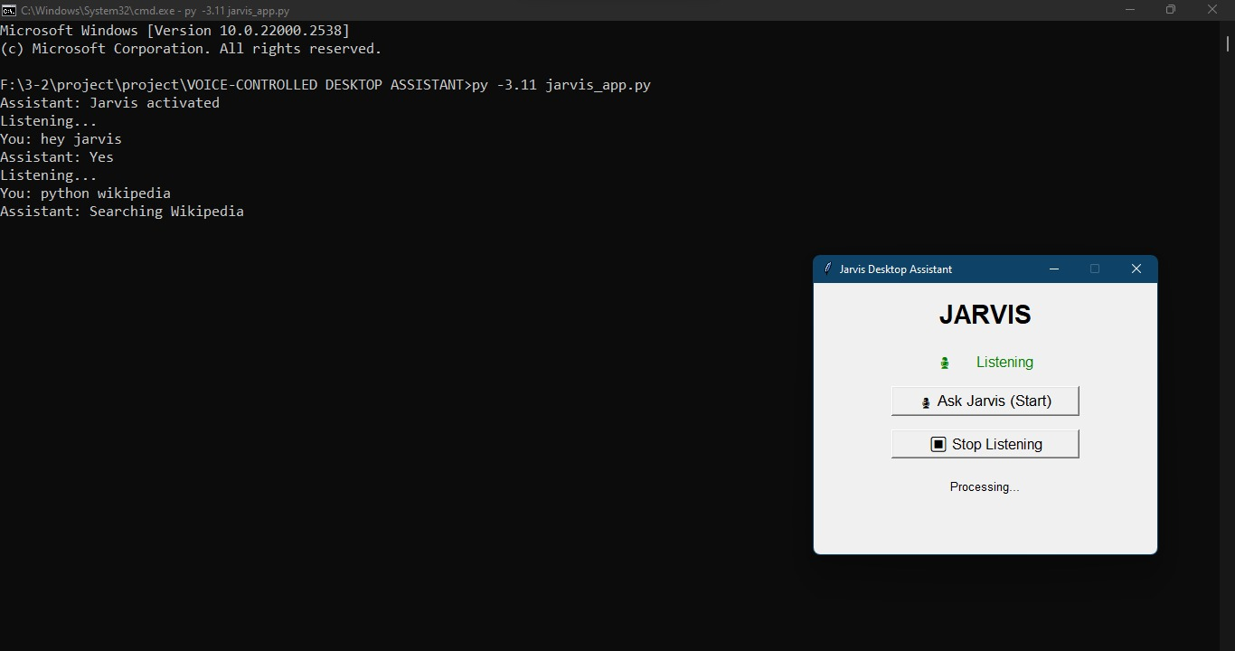
RESULTS/OUTPUT SCREENS

Slide 23
RESULTS/OUTPUT SCREENS

Slide 24
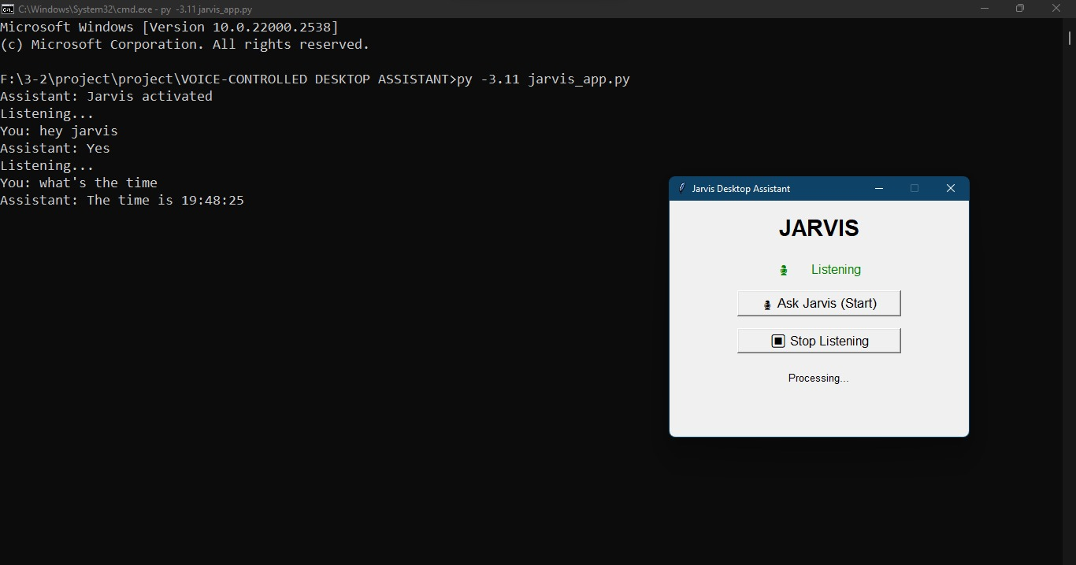
RESULTS/OUTPUT SCREENS

Slide 25
CONCLUSION
The Jarvis voice assistant project successfully demonstrates a voice-based interaction system using Python.
It captures voice input, processes commands, and performs tasks efficiently.
The system improves user experience by reducing manual effort and providing a natural way of interaction.
It is simple, effective, and suitable for beginners to understand automation and speech processing.

Slide 26
FUTURE SCOPE
Integration with Artificial Intelligence and NLP
Support for multiple languages (Hindi, Telugu, etc.)
Development as a mobile application
Integration with smart home devices (IoT)
Improved security features (voice authentication)
Addition of advanced features like reminders, weather updates, and automation

Slide 27
REFERENCES
Python Software Foundation, Python Documentation. Available: https://www.python.org/documentation/
SpeechRecognition Library Documentation (PyPI). Available: https://pypi.org/project/SpeechRecognition/
pyttsx3 Library Documentation (PyPI). Available: https://pypi.org/project/pyttsx3/
Wikimedia Foundation, Wikipedia API Documentation. Available: https://www.mediawiki.org/wiki/API:Main_page
Google Cloud, Speech-to-Text API Overview. Available: https://cloud.google.com/speech-to-text
Various online tutorials and research articles related to Python and voice assistant development

Slide 28
THANK YOU !

